Slide 1


CHICAGO CRIME DATASET
ANALYSIS USING POWERBI
Presented by: Khadijat Abubakar

Slide 2
PROBLEM STATEMENT
To create a comprehensive Power BI dashboard that provides insights into the crime data of Chicago. The goal is to help city officials, law enforcement agencies, and the public understand crime trends, identify high crime areas, and make data driven decisions to improve public safety.

Slide 3

DATASET OVERVIEW
The dataset consists of the following columns:
ID: Unique identifier for each crime incident.
Case Number: Unique case number assigned to each crime incident.
Date: Date and time when the crime occurred.
Block: Block address where the crime occurred.
IUCR: Illinois Uniform Crime Reporting code.
Primary Type: Primary classification of the crime (e.g., theft, assault).
Description: Detailed description of the crime.
Location Description: Description of the crime location (e.g., street, residence).
Arrest: Indicates whether an arrest was made (True/False).
Domestic: Indicates whether the crime was domestic-related (True/False).
Beat: Smallest police geographic area.
District: Police district where the crime occurred.
Ward: Ward where the crime occurred.
Community Area: Community area where the crime occurred.
FBI Code: FBI crime classification.
X Coordinate: X coordinate of the crime location.
Y Coordinate: Y coordinate of the crime location.
Year: Year when the crime occurred.
Updated On: Date when the record was last updated.
Latitude: Latitude coordinate of the crime location.
Longitude: Longitude coordinate of the crime location.
Location: Combined latitude and longitude as a single field.

Slide 4
PROJECT OBJECTIVES
Identify trends in crime rates over different periods ( monthly, yearly).
Analyze the distribution of different types of crimes (e.g., theft, assault, burglary).
Identify any seasonal or temporal patterns in crime rates ( during certain months).
Identify high crime areas.
Identify patterns and trends in domestic-related crimes.

Slide 5

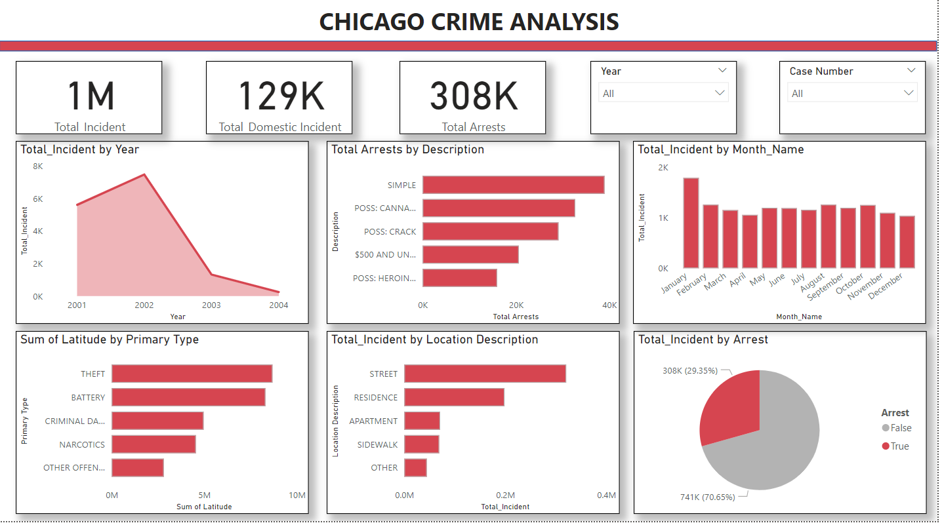
DASHBOARD

Slide 6
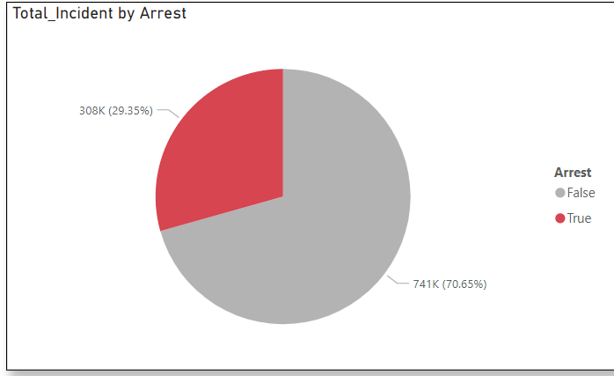
This pie chart explains the Arrest by the total incident.

Slide 7
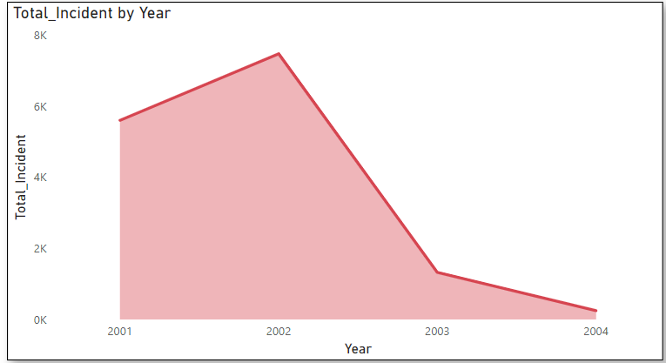

this line chart explain the total incident by year which says year 2002 has the most incident in chicago followed by year 2001.

Slide 8

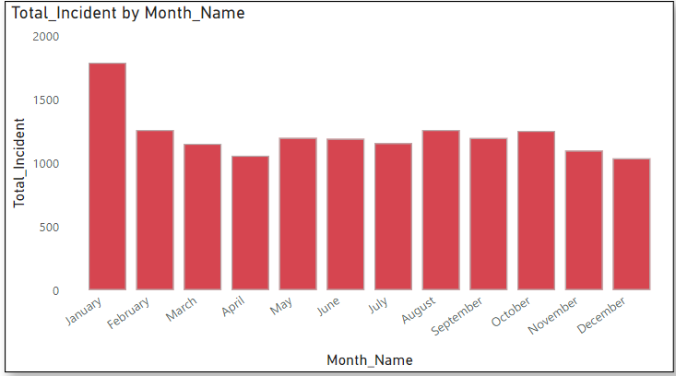

This chart illustrate the total incident by month name which say january has the highest total incident.

Slide 9
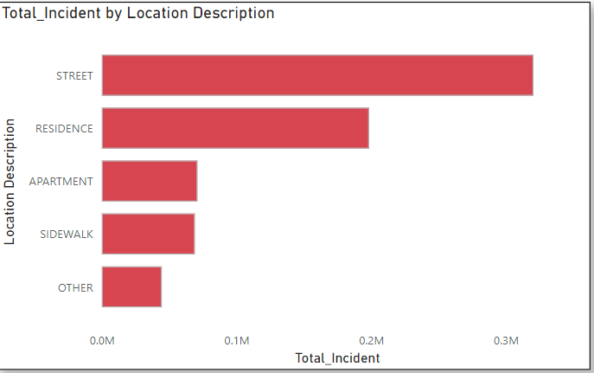
This chart explains that most crime are taking place on the street followed by residence, apartment and sidewalk.

Slide 10
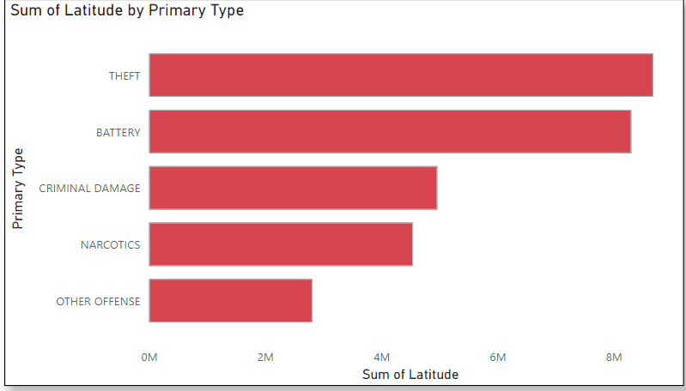
This chart ilustrate the top 5 latitude by primary type. which implies that theft is the highest crime type in chicago.

Slide 11
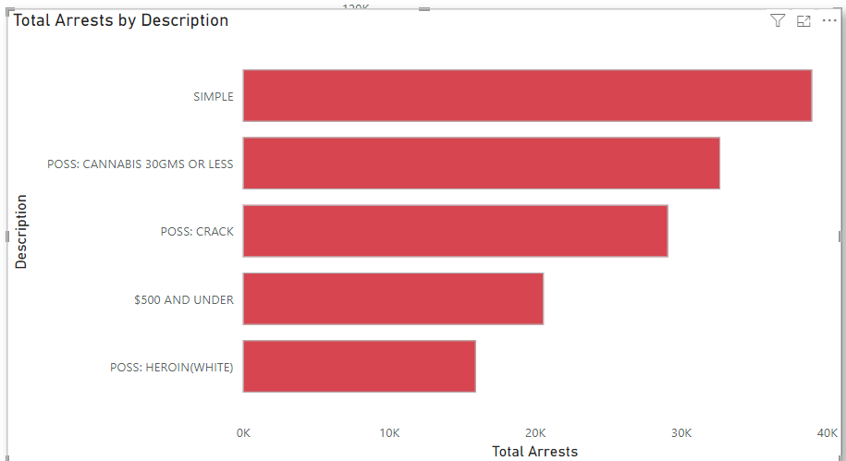
This chart explain the top 5 total arrest by description which says simple has the highest total arrest.

Slide 12
INSIGHT
The overall crime rate in Chicago has shown an increase in 2002 with significant fluctuations during specific 2003.
The most common crime types are ( Theft, Batery, Criminal Damage, Narcostics ) .
Crime rates tend to be higher during January followed by August.
False Domestic Arrest constitute a higher proportion compared to True Domestic Arrests.
Streets are the Most Common Crime Locations.

Slide 13
RECOMMENDATION
Increase police presence in identified high-crime areas such as Community Area and District Implement hotspot policing and place-based interventions to deter criminal activities.
Enhance support services for domestic violence victims, including shelters, counseling, and legal aid. Increase public awareness about domestic violence and encourage reporting. Partner with social services to provide comprehensive support to affected families.
Adjust police schedules to cover high-crime periods effectively, such as late evenings, weekends, and specific months. Use predictive policing models to anticipate and prevent crime spikes.
Regularly update and analyze the crime dataset to keep track of trends and patterns.

Slide 14
THANK'S FOR WATCHING

